Slide 1

Custom Report Generation Use Case
Use Case Description and Requirements

Slide 2
Scenario Overview
Strategic Dimension is designing the new feature for its Odoo-based ERP system
This system will allow the users to generate custom reports
This will make it easy for users to create reports that fits their needs
It help users to analyze data better and make smarter decisions for organization

Slide 3
Navigating Custom Reports
Primary Actor : User
Goal : Empower users to create reports that fit their needs, so that the can make wise decision using data in organization.
Precondictions : Before creating reports, the user must be authenticated and has access to the custom report generation feature and ensure the system works well.

Slide 4
Main Success Scenario
User access the Odoo-based system and navigate through custom report feature.
Tell system what you need by selecting the date, report style or format and data range.
The system processes it the user’s selections and generate custom report accordingly.
The system gives option of download or view.
Mission accomplished – User successfully downloads or views the custom report.

Slide 5
Postcondiction
User can download or view custom report
System keeps the record of successful

Slide 6
Extension
If system encounters an error during the process of generating report, notify the user and give relevant details.
If the user decide to cancel the report process, terminate the process and return to main menu

Slide 7
Requirements Documentation
Functional Requirements
The system provides friendly place to create reports for user.
Users shall able to select specific criteria such as report format, data range and filters.
The system shall generate report in format of PDF, CSV and EXCEL
Error message shall display if there is issue during the report generation

Slide 8
Requirements Documentation
Non-Functional Requirements
System should respond fast for normal report.
System should able to handle multiple users simultaneously.
The custom report generation feature shall able to work on mobile and desktop.

Slide 9
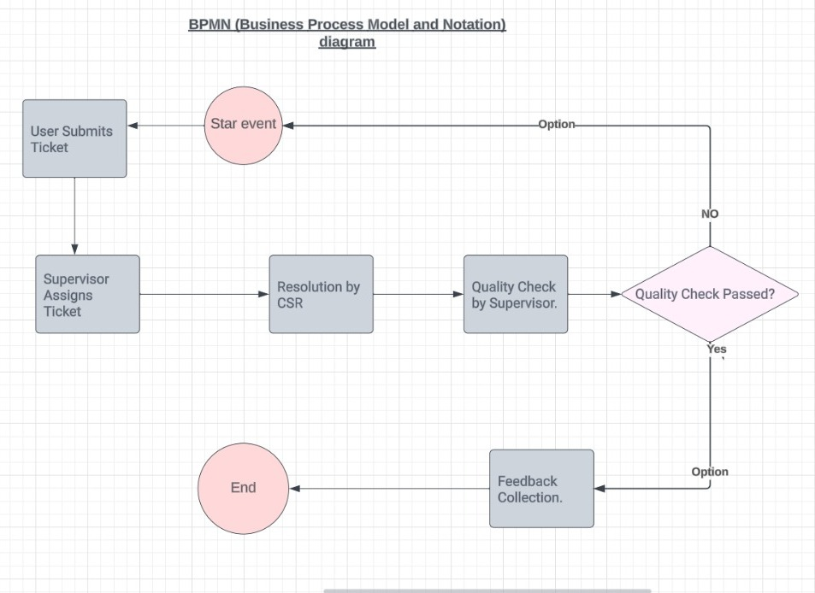
Business Process Modeling Process of customer support ticket resolution.

Slide 10
Stories and Acceptance criteria Story 1: Business Analyst's Monthly Sales Lost Report
As a business analyst, I want to generate report on monthly lost sales so that I can analyze and improve business better.
Acceptance Criteria
When I select custom report generation feature, there should be option of “Monthly sales lost”.
I should able to select any date in case want to check on specific date.
The system generate PDF report to provide details on opportunity we lost .

Slide 11
Stories and Acceptances criteria Story:2 Product manager’s new product launch Report
As product manager I want generate custom report on performance on new launched product and see how customer react and impact on sale.
Acceptance Criteria :
Custom report should generate feature such as “New product launch”.
System should allow the user to select a date for product launch.
System generate CSV report format representing sale figures and feedback on new product.

Slide 12
Stories and Acceptance criteria Story:3 HR Manager employee attendance Report
As HR Manager, I want to generate custom report to track the attendance of works and identify the pattern.
Acceptance Criteria :
In custom report generation features, there must be “Employee attendance”
Th system should allow user to select any date to check attendance.
The system should be generated in EXCEL format to present employee’s details including present and absence days.

